Slide 1
Healthhack 2015 The Royal Australian College of General Practitioners (RACGP) ROTATION ROSTER PORTAL
Contributors
(RACGP) Monika Buljan – Statistician And Project Owner
(RACGP) Hema Nathen – Project Analyst
Tim Rice – Various Mathematics And Statistics
Tania Licea – Designer/Project Manager
Miguel Sanchez – JS Expert
Terry Dai – Mobile App Developer
Rayen Magpantay – JS Expert
Notes:
5 seconds

Slide 2
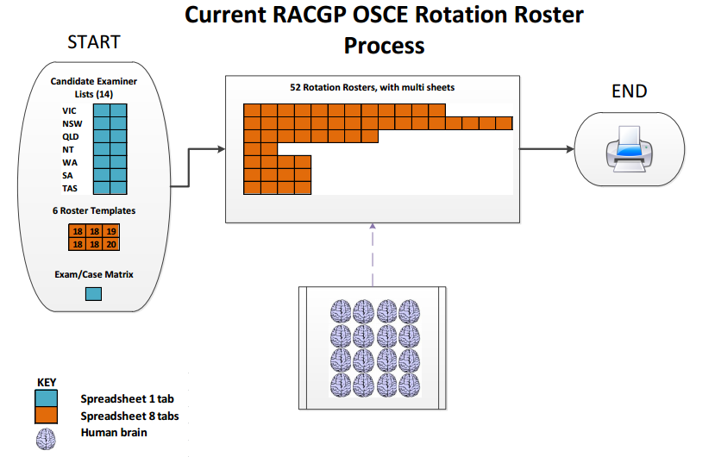
Issue definition
Notes:
30 seconds
The RACGP will run a clinical exam with over 800+ Candidates and over 2000 GP examiners.
Rotation Roster: candidates split in groups of 18-20 which equals 1 rotation, equals 1 spread sheet.
7 States coordinate multiple venues on the same date with am /pm sessions
Over 15 admins: Complete rosters according to availability of examiners; at the end, they print rosters.

Slide 3
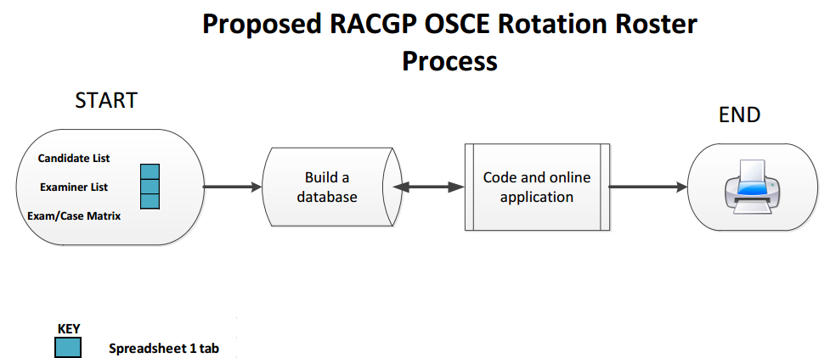
Proposed Solution
ROTATION ROSTER PORTAL
Notes:
30 seconds
The solution is to import 3 spread sheets into a database that connects to web portal allowing admins to coordinate and print rosters
Advantages:
More organised, used-friendly interface
-- Faster for Admins as they get a first draft of rosters and they just need to consider anomalies e.g. conflict of interest
– Admin don’t need to manage multiple spread sheets/ is an all in one system

Slide 4
PROTOTYPE
Notes:
45 seconds

Slide 5
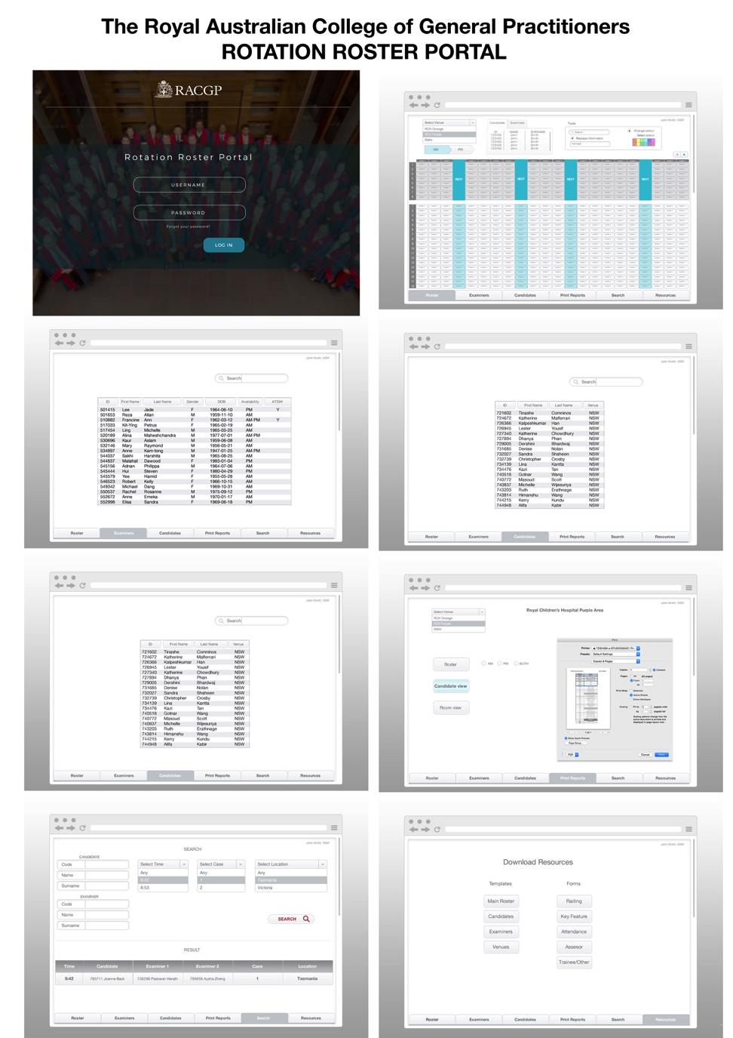
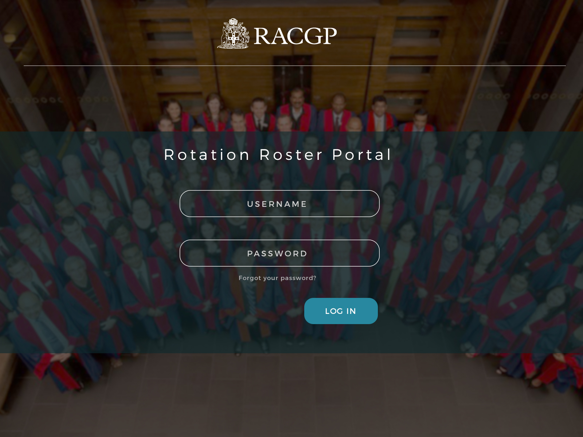
rotation roster portal
Live DEMO
Notes:
Play demo. 45 seconds

Slide 6
Limitations and future work
LIMITATIONS / CHALLENGES
Replicate the Excel Master Roster in code (Web Portal).
Getting various components to work together (R- Mongo DB - NodeJS and Angular)
Time – To allow more functionalities e.g. Flexi start time, print formatting.
FUTURE
Consider the manual replacement of Examiners due to conflicts of interest.
Develop the Search function.
Detailed printing functions
Notes:
20 seconds
LIMITATIONS
not enough time to have flexibility for more functionalities

Slide 7
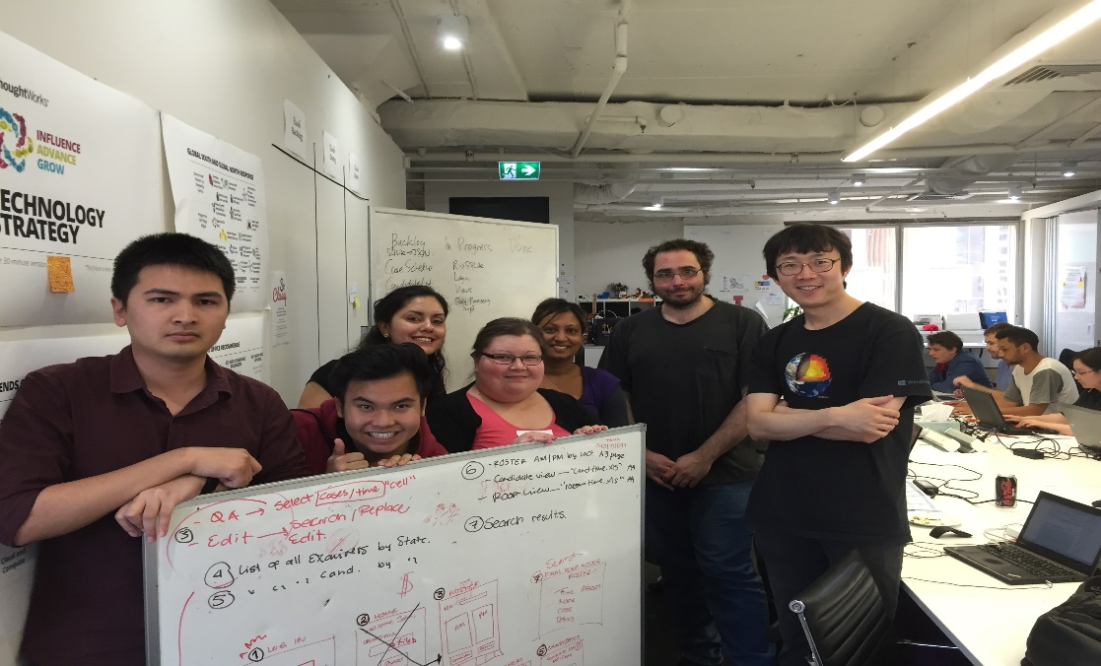
thanks
Notes:
5 seconds

